Slide 1
Human-Aligned Adversarial Defense: Combining Robust Features + PGD Training
CS/ML Security Final Project — University of Utah
Student: Ananya Ananth
Date: 2nd December 2025

Slide 2
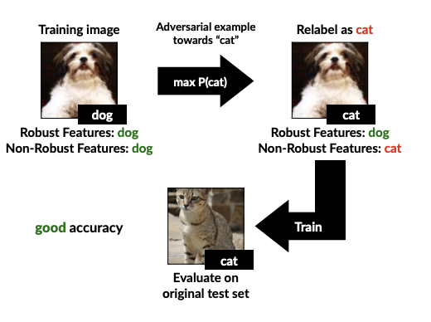
Motivation: Why This Problem Matters
Deep neural networks are powerful but fragile.
Tiny, imperceptible perturbations can force wrong predictions.
Standard models:
  High clean accuracy,
  0% adversarial robustness.
Security-critical systems (medical, autonomous, finance) cannot tolerate this.
Key Question:
Can we build models that behave more like humans and don’t fall apart under adversarial manipulation?

Slide 3
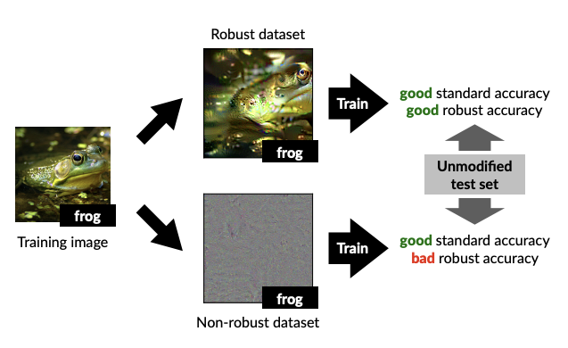
Problem Statement
Most adversarial training methods rely heavily on non-robust features
(predictive for ML models, irrelevant to humans).
A research paper called "Adversarial Examples Are Not Bugs, They Are Features" (Ilyas et al. (2019)) showed existence of robust features:
  Human-aligned
  Naturally resistant to adversarial perturbations
But:
  Training only on robust features reduces accuracy
  PGD alone improves robustness but loses interpretability
  Goal:
  Combine robust human-aligned features + PGD adversarial training. See if we get a model that is both secure and human-like.

Slide 4
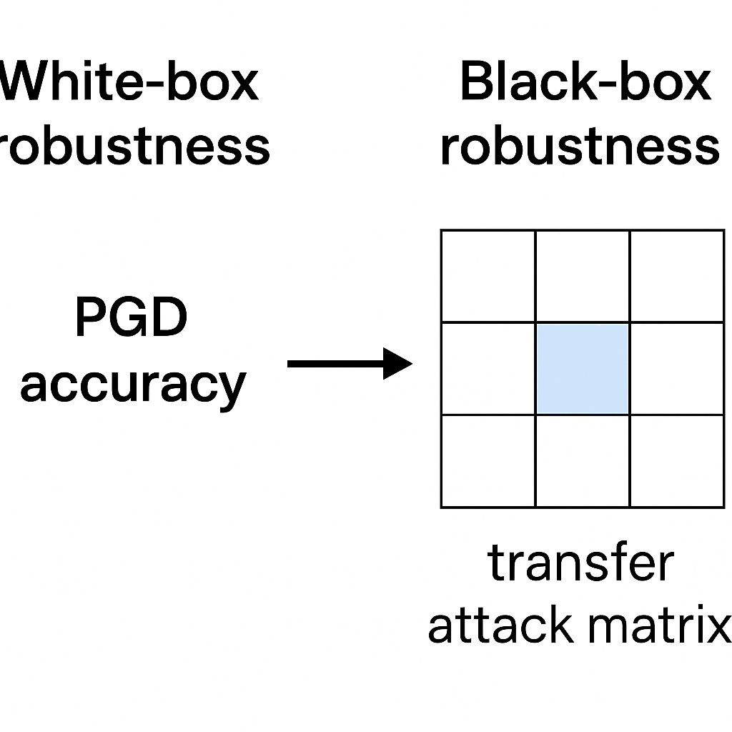
Threat Model
Attacker Capability Types:
White-box attacker
  Has full access to model weights & gradients
  Uses strong PGD (20-step, ε=8/255)
Black-box attacker
  Cannot see gradients
  Uses a surrogate model to craft adversarial examples
  Uses the transferability phenomenon
  We evaluate BOTH:
White-box robustness → PGD accuracy
Black-box robustness → transfer attack matrix
Real-world relevance: Black-box transfer attacks are the TRUE threat model for deployed ML systems.

Slide 5
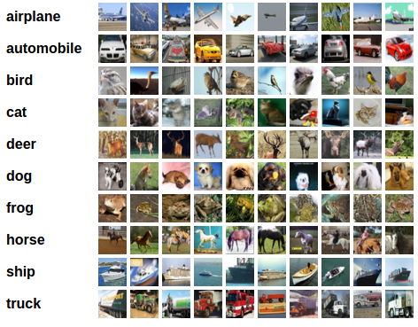
Datasets Used
1. Standard CIFAR-10
Natural images
Contains robust + non-robust features
2. Robust CIFAR-10 (Ilyas et al.)
Generated through robust feature synthesis
Contains only robust, human-aligned features
Naturally resistant to gradient-based attacks
Why this matters: Training on this dataset forces the model to learn only human-relevant signals.

Slide 6
Models Trained (4 Baselines)
Model | Description
Standard | Normal training on CIFAR-10
Robust Only | Train on robust-feature dataset only
PGD Only | Adversarial training on standard CIFAR-10
Proposed (Robust + PGD) | Mix robust dataset + PGD training

Slide 7
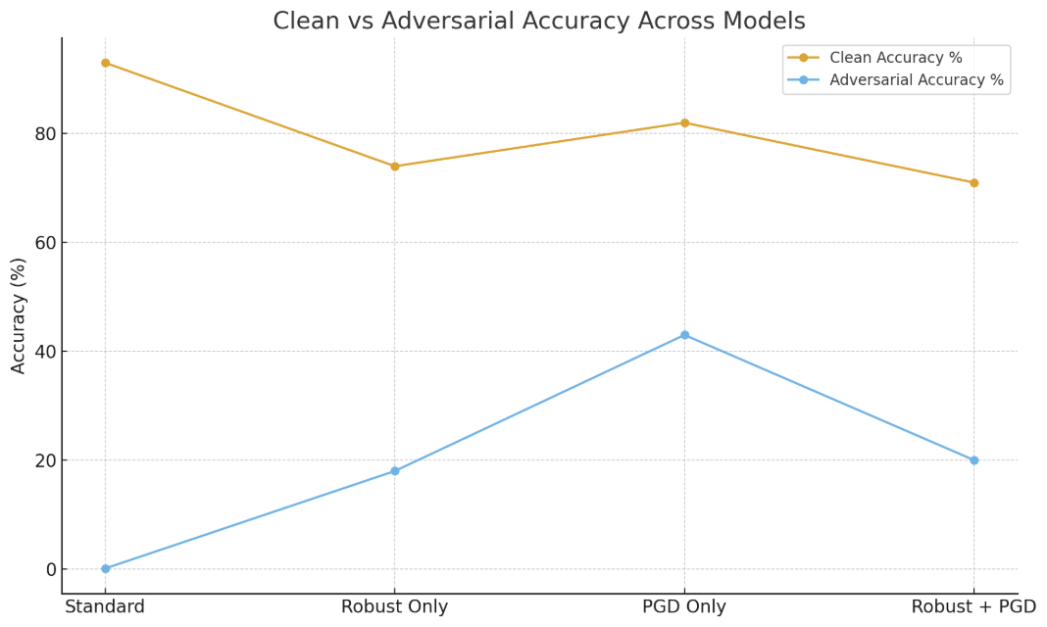
White-Box Results (PGD Attack, ε=8/255)
Interpretation:
As expected, PGD-only is strongest in white-box.
Robust+PGD is not highest under PGD → and that is OK. Because PGD relies on non-robust features that the robust dataset intentionally removes.
White-box PGD does not reflect real-world attackers.
Model | Clean Accuracy (%) | Adversarial Accuracy (%)
Standard | 93 | 0
Robust Only | 74 | 18
PGD Only | 82 | 43
Proposed (Robust + PGD) | 71 | 20

Slide 8
The Real-World Threat Model: Transfer Attacks
Why transfer attacks?
Attackers rarely have access to gradients.
They generate adversarial examples on a surrogate model.
The examples transfer to the target.
Metric:
Transfer Attack Robustness = accuracy when attacked by another model.
This is the core security contribution here.

Slide 9
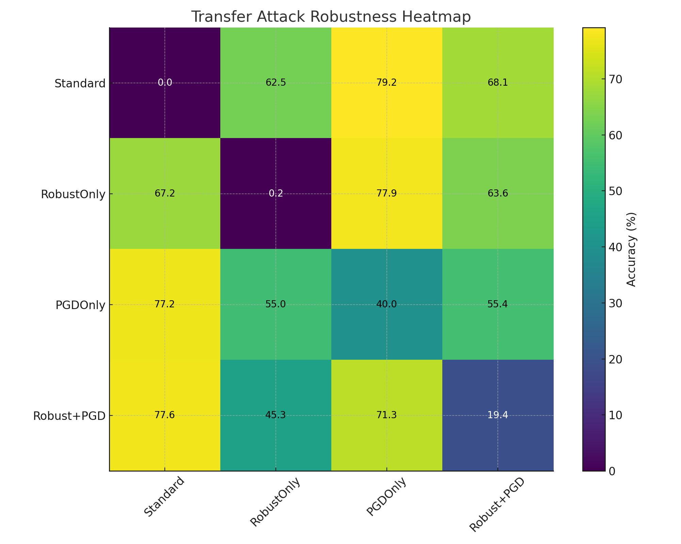
Transfer Attack Robustness Matrix (Your Heatmap)
Each row is an attacker; each column is the model attacked.

Slide 10
Key Findings from Transfer Matrix
1. Proposed Model = Highest Black-Box Robustness
Example:
Attacks from Standard → Robust+PGD: 68.11%
Attacks from RobustOnly → Robust+PGD: 63.58%
Attacks from PGDOnly → Robust+PGD: 55.44%
This is strong, consistent robustness.

Slide 11
Why Is My Model the Best in Transfer Robustness?
Because:
It uses human-aligned features (from robust dataset)
Combined with PGD adversarial alignment
It ignores model-specific non-robust patterns
Features generalize → harder to exploit even with surrogate models
This means:️ The proposed model has better REAL-WORLD security.

Slide 12
Comparison Table: Theory vs Reality
Model | White-box Robustness | Transfer Robustness | Security Verdict
Standard | ❌ 0% | ❌ low | Worst
Robust Only | ⚠️ low | ✔ high | Human-aligned but incomplete
PGD Only | ✔ strong | ⚠️ moderate | Strong white-box only
Proposed | ⚠️ moderate | ✔✔ highest | Best overall real-world security

Slide 13
Security Interpretation
"White-box PGD robustness does not equal real-world security.”
This developed model:
Performs well under unknown attacker models
Uses features that humans rely on
Is less dependent on brittle, non-robust signals
Shows superior black-box robustness

Slide 14
Limitations
Slightly lower white-box PGD robustness
Model capacity (ResNet-18) limits performance
Future work: WRN-34-10, TRADES, RRM-based feature alignment

Slide 15
Conclusion
“In a world where attackers rarely know your model,
white-box accuracy is not a reliable measure of security.”
This model, trained on human-aligned robust features and hardened with PGD, demonstrates the strongest transfer robustness among all baselines.
It is a secure model under realistic adversarial conditions as it is:
✔ Human-aligned
✔ Hard to fool
✔ Feature-generalized
✔ Black-box robust
Bottom Line: The developed model wins where it truly matters: real-world adversarial security 🔥

Slide 16
Thank you

